Slide 1
Module 2

Slide 2
Physical layer: Guided Media, Unguided Media, Wireless Transmission: Electromagnetic Spectrum. Switching: Circuit-Switched Networks, Packet Switching, Structure Of A Switch
DLL Design Issues (Services, Framing, Error Control, Flow Control), Error Detection and Correction(Hamming Code,Parity, CRC, Checksum) , Elementary Data Link protocols : Stop and Wait, Sliding Window(Go Back N, Selective Repeat), Piggybacking, HDLC
Medium Access Protocols: Random Access, Controlled Access, Channelization. Ethernet Protocol: Standard Ethernet, Fast Ethernet (100 Mbps), Gigabit Ethernet, 10-Gigabit Ethernet

Slide 3
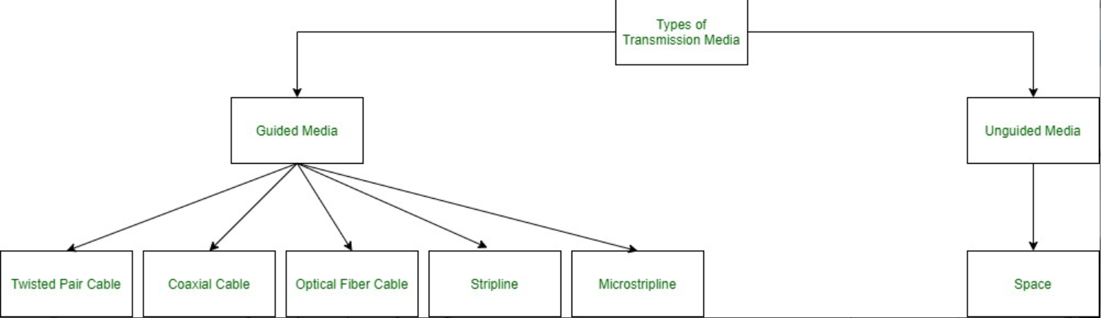
In data communication terminology, a transmission medium is a physical path between the transmitter and the receiver i.e. it is the channel through which data is sent from one place to another. Transmission Media is broadly classified into the following types:

Slide 4
1. Guided Media: It is also referred to as Wired or Bounded transmission media. Signals being transmitted are directed and confined in a narrow pathway by using physical links. Features:
High Speed
Secure
Used for comparatively shorter distances

Slide 5
There are 3 major types of Guided Media:
(i) Twisted Pair Cable – It consists of 2 separately insulated conductor wires wound about each other. Generally, several such pairs are bundled together in a protective sheath. They are the most widely used Transmission Media. Twisted Pair is of two types:

Slide 6

Unshielded Twisted Pair (UTP): UTP consists of two insulated copper wires twisted around one another. This type of cable has the ability to block interference and does not depend on a physical shield for this purpose. It is used for telephonic applications.

Slide 7
Advantages:
⇢ Least expensive
⇢ Easy to install
⇢ High-speed capacity
⇢ Susceptible to external interference
⇢ Lower capacity and performance in comparison to STP
⇢ Short distance transmission due to attenuation

Slide 8
Shielded Twisted Pair (STP): This type of cable consists of a special jacket (a copper braid covering or a foil shield) to block external interference. It is used in fast-data-rate Ethernet and in voice and data channels of telephone lines.

Slide 9
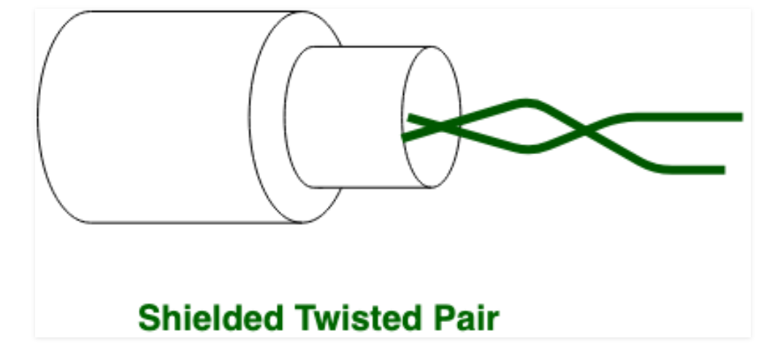

Slide 10
Advantages:
⇢ Better performance at a higher data rate in comparison to UTP
⇢ Eliminates crosstalk
⇢ Comparatively faster
⇢ Comparatively difficult to install and manufacture
⇢ More expensive
⇢ Bulky

Slide 11
(ii) Coaxial Cable – It has an outer plastic covering containing an insulation layer made of PVC or Teflon and 2 parallel conductors each having a separate insulated protection cover. The coaxial cable transmits information in two modes: Baseband mode(dedicated cable bandwidth) and Broadband mode(cable bandwidth is split into separate ranges). Cable TVs and analog television networks widely use Coaxial cables.

Slide 12
(ii) Coaxial Cable – It has an outer plastic covering containing an insulation layer made of PVC or Teflon and 2 parallel conductors each having a separate insulated protection cover. The coaxial cable transmits information in two modes: Baseband mode(dedicated cable bandwidth) and Broadband mode(cable bandwidth is split into separate ranges). Cable TVs and analog television networks widely use Coaxial cables.

Slide 13
Advantages:
High Bandwidth
Better noise Immunity
Easy to install and expand
Inexpensive
Disadvantages:
Single cable failure can disrupt the entire network

Slide 14
(iii) Optical Fiber Cable – It uses the concept of reflection of light through a core made up of glass or plastic. The core is surrounded by a less dense glass or plastic covering called the cladding. It is used for the transmission of large volumes of data.
The cable can be unidirectional or bidirectional. The WDM (Wavelength Division Multiplexer) supports two modes, namely unidirectional and bidirectional mode.

Slide 15
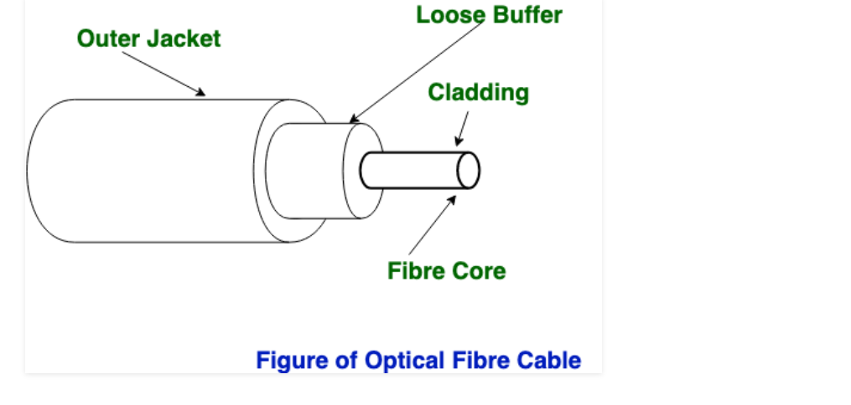

Slide 16
Advantages:
Increased capacity and bandwidth
Lightweight
Less signal attenuation
Immunity to electromagnetic interference
Resistance to corrosive materials
Disadvantages:
Difficult to install and maintain
High cost
Fragile

Slide 17
2. Unguided Media: It is also referred to as Wireless or Unbounded transmission media. No physical medium is required for the transmission of electromagnetic signals.
Features:
The signal is broadcasted through air
Less Secure
Used for larger distances

Slide 18
There are 3 types of Signals transmitted through unguided media:
(i) Radio waves – These are easy to generate and can penetrate through buildings. The sending and receiving antennas need not be aligned. Frequency Range:3KHz – 1GHz. AM and FM radios and cordless phones use Radio waves for transmission.

Slide 19
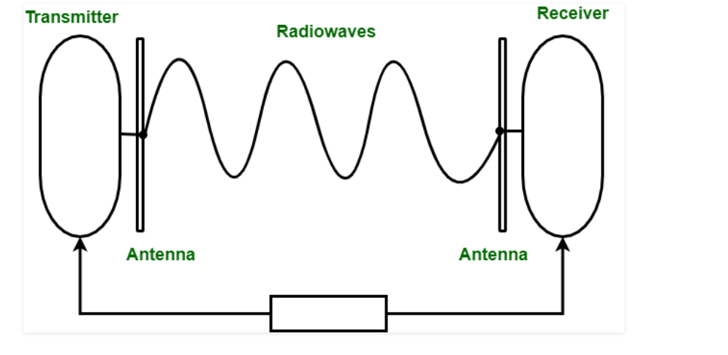

Slide 20
(ii) Microwaves – It is a line of sight transmission i.e. the sending and receiving antennas need to be properly aligned with each other. The distance covered by the signal is directly proportional to the height of the antenna. Frequency Range:1GHz – 300GHz. These are majorly used for mobile phone communication and television distribution.

Slide 21
(iii) Infrared – Infrared waves are used for very short distance communication. They cannot penetrate through obstacles. This prevents interference between systems. Frequency Range:300GHz – 400THz. It is used in TV remotes, wireless mouse, keyboard, printer, etc.

Slide 22
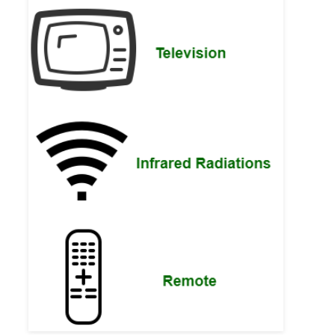

Slide 23
Wireless Transmission
• The Electromagnetic spectrum
• Radio Transmission
• Microwave transmission
• Infrared and millimeter waves
• Light wave transmission

Slide 24
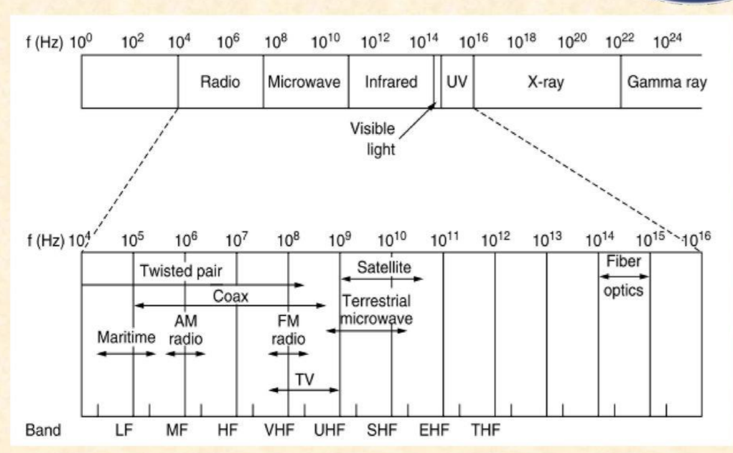
The Electromagnetic spectrum

Slide 25
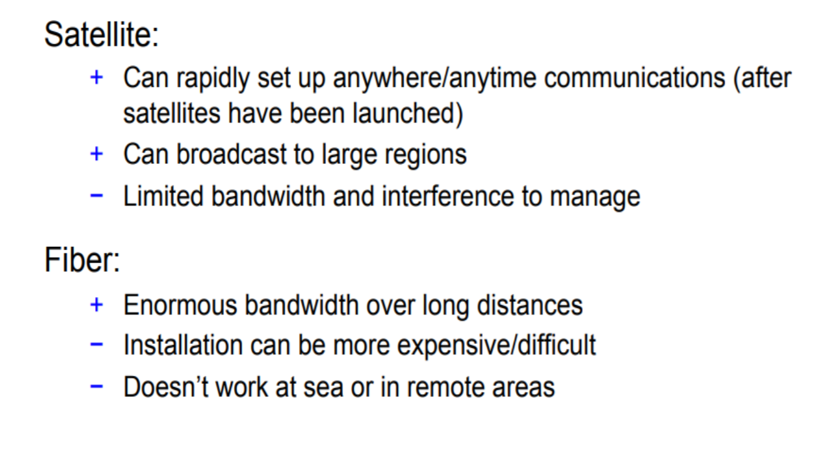
Satellite vs fibre

Slide 26
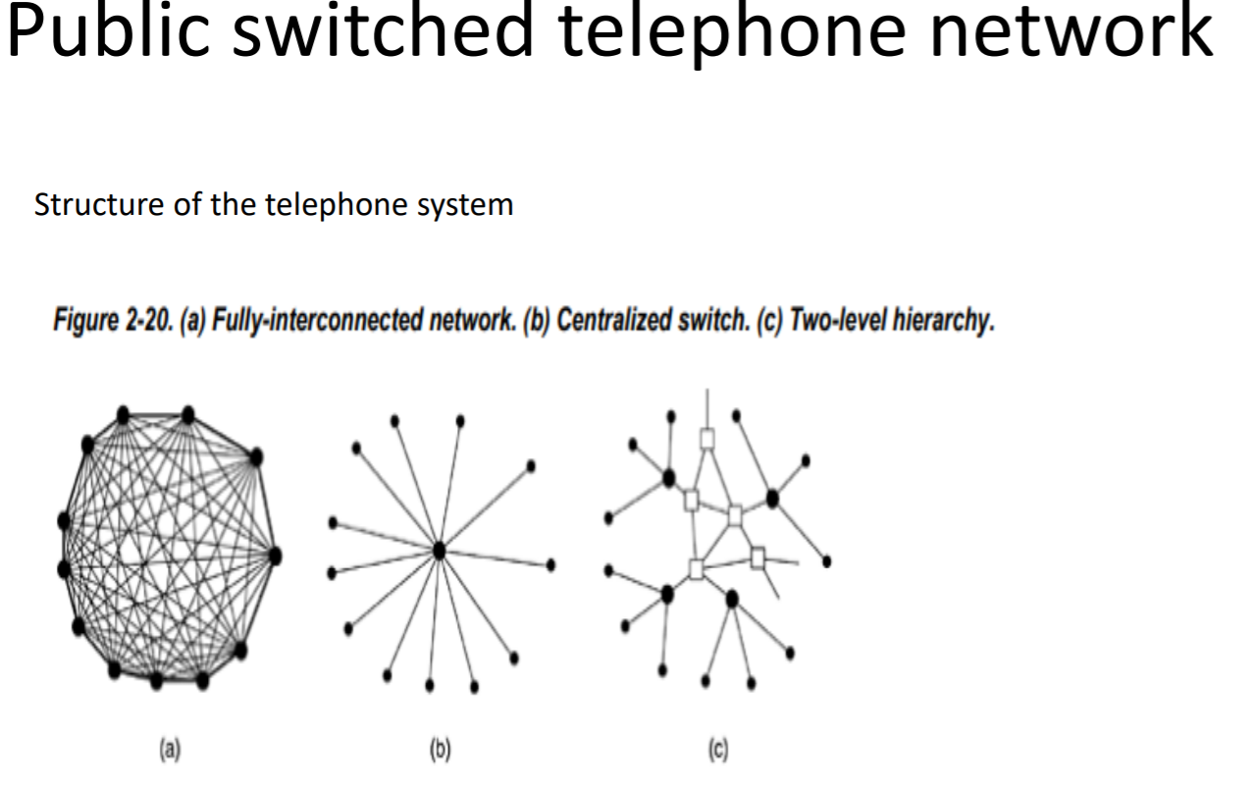

Slide 27
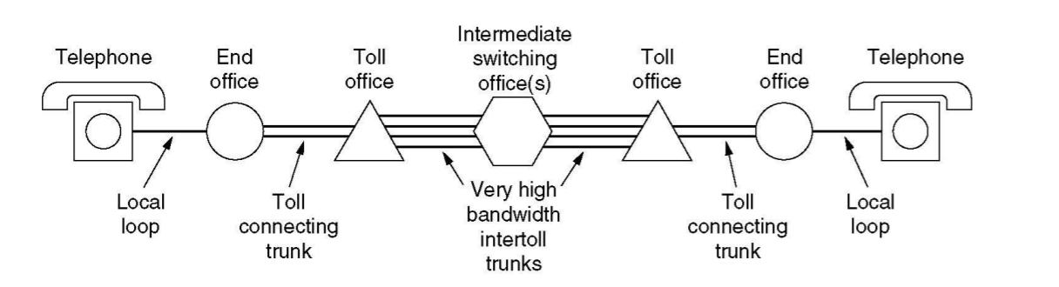
PSTN
• A typical circuit route for a medium-distance call

Slide 28
Major Components of the Telephone System
– Local loops: Analog twisted pairs going to houses and businesses
– Trunks: Digital fiber optics connecting the switching offices
– Switching offices: Where calls are moved from one trunk to another

Slide 29
DLL Design Issues (Services, Framing, Error Control, Flow Control),
Error Detection and Correction(Hamming Code,Parity, CRC, Checksum) ,
Elementary Data Link protocols : Stop and Wait, Sliding Window(Go Back N, Selective Repeat), Piggybacking, HDLC

Slide 30
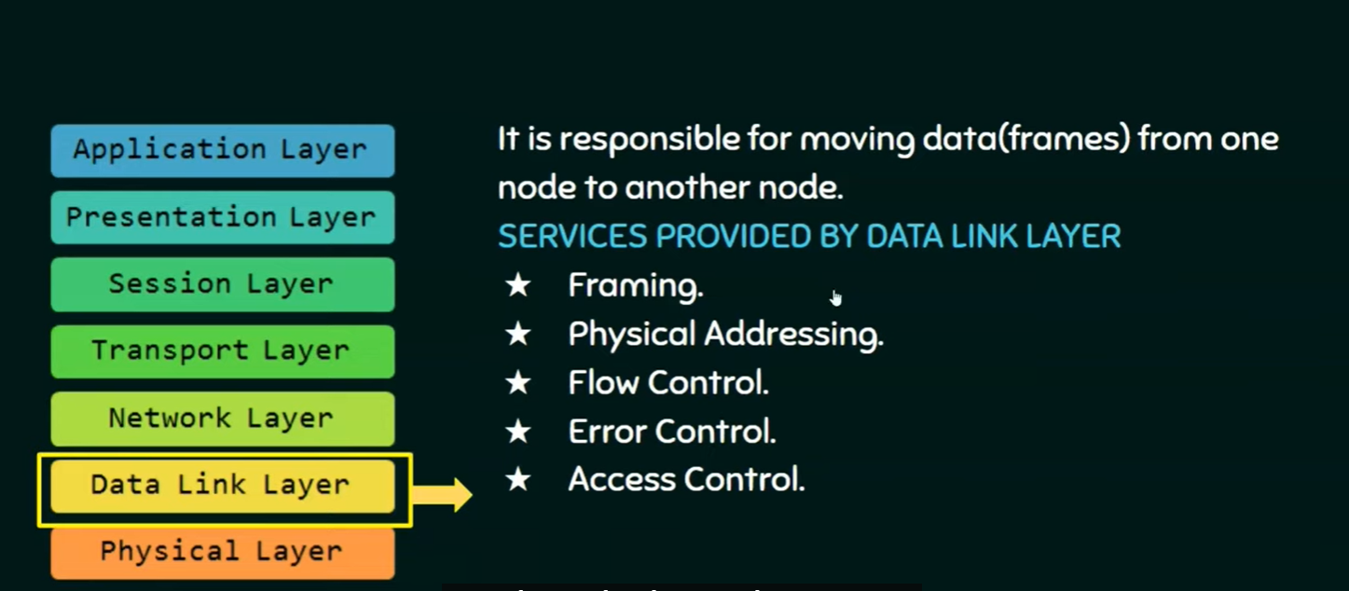
Services, Framing, Error Control, Flow Control

Slide 31
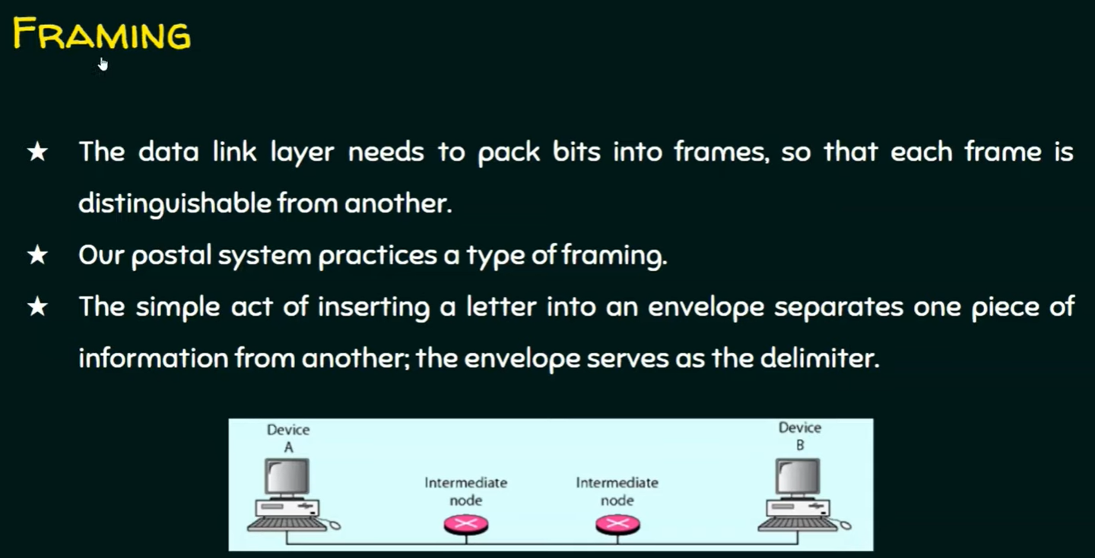

Slide 32
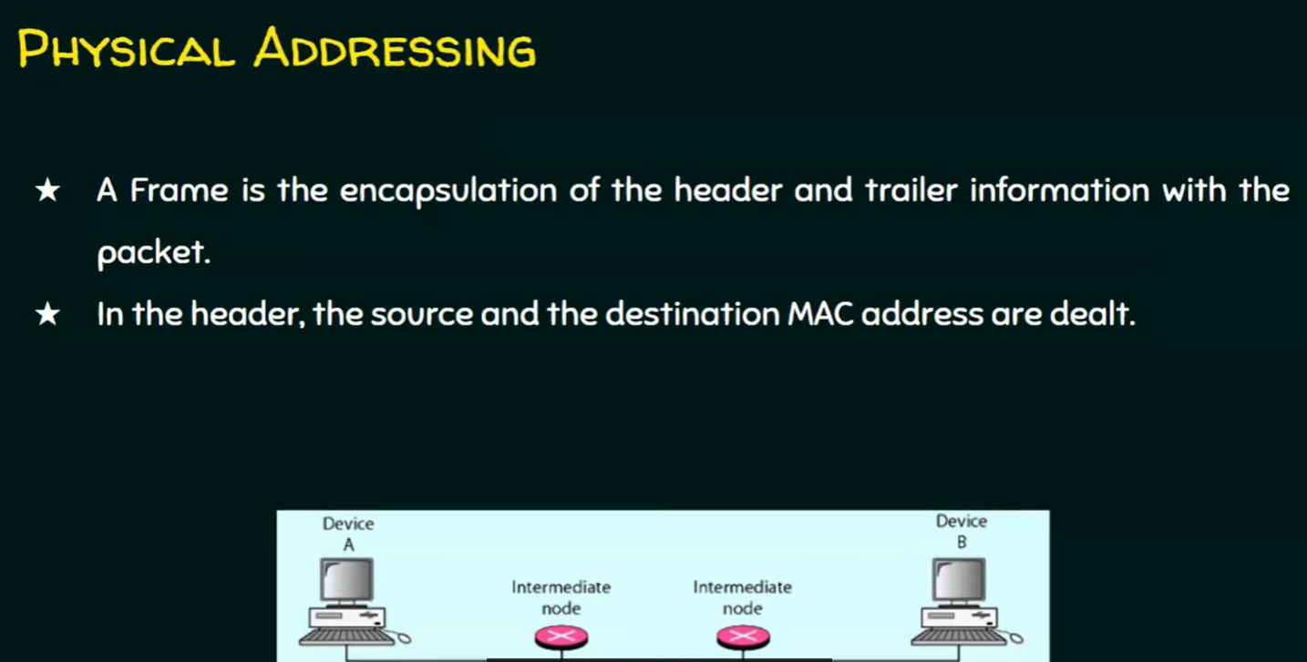

Slide 33
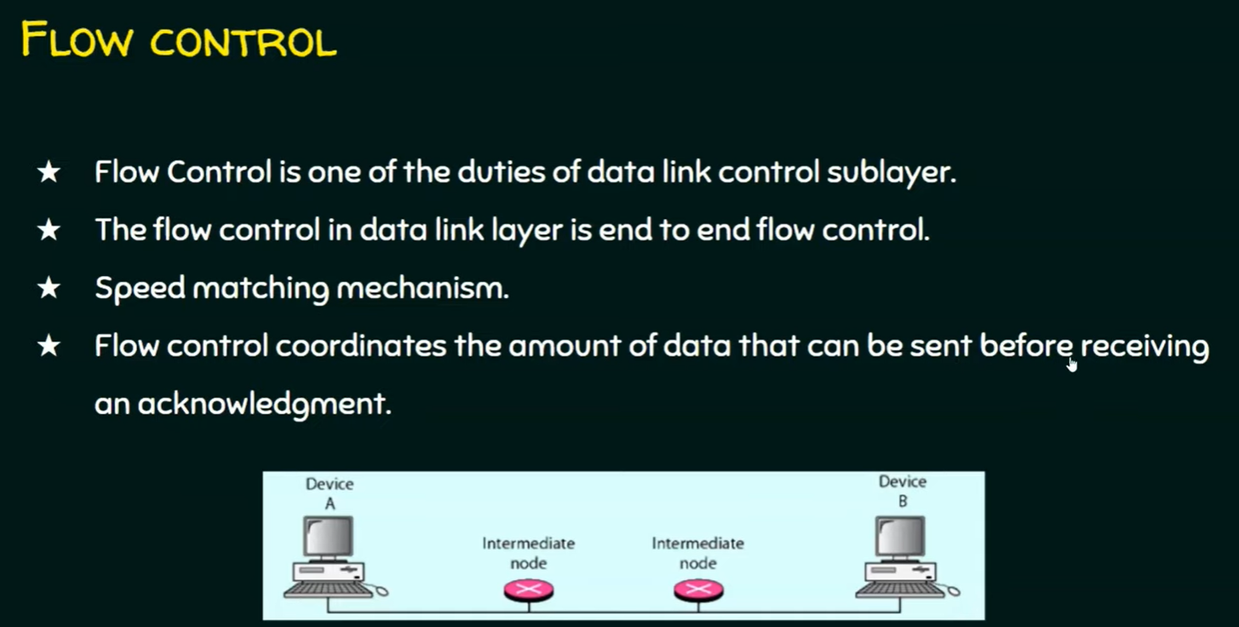

Slide 34
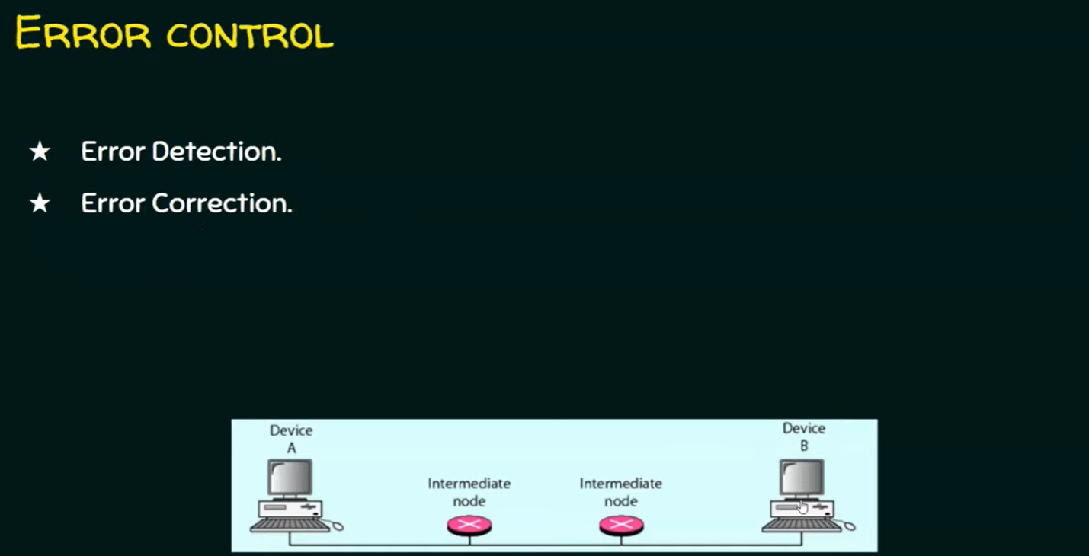

Slide 35
Error detection and correction

Slide 36
Medium Access Protocols:
Random Access, Controlled Access
Channelization. Ethernet Protocol: Standard Ethernet
Fast Ethernet (100 Mbps)
Gigabit Ethernet
10-Gigabit Ethernet

